Slide 1

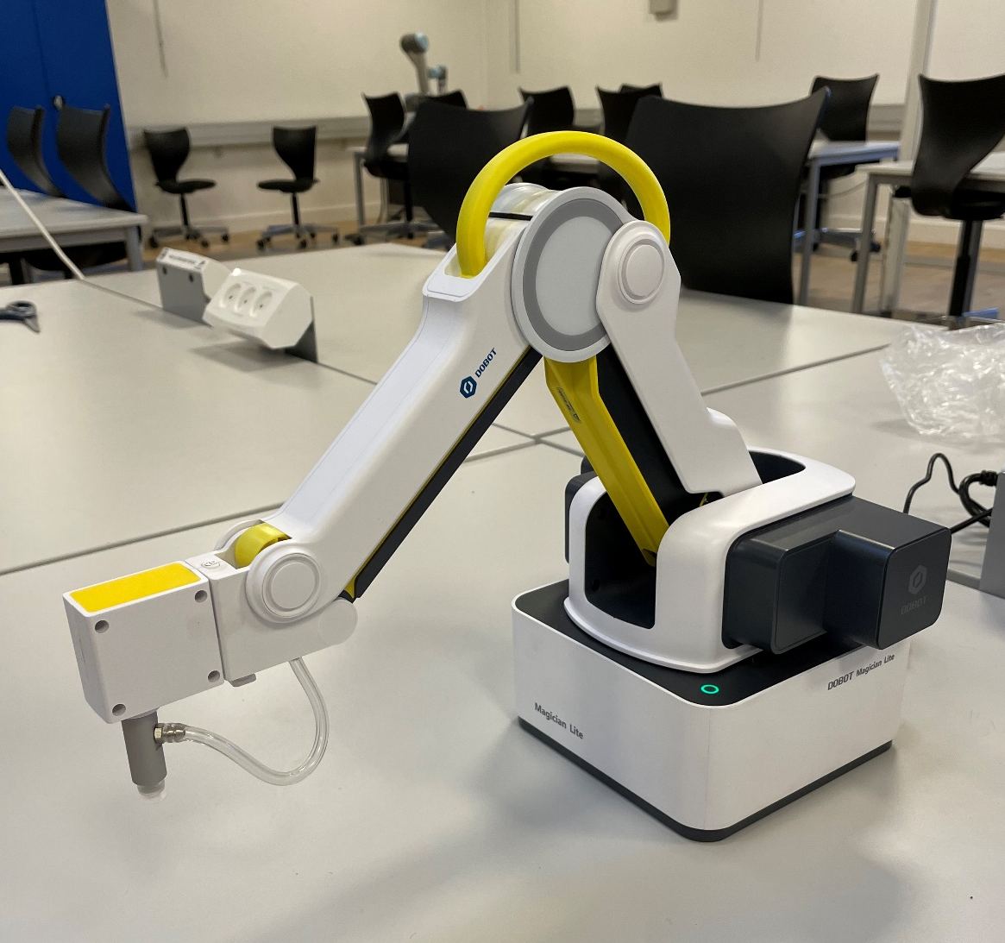

Robotkinematik I EN DoBot
Af Jesper Roager

Slide 2
Problemformuleringen
Hvordan bruges matricer til at udregne position af leddene i dobotten for at nå en given position inden for robottens rækkevidde?

Slide 3
Konklusionen
Forward- og Inverse kinematik fundet for Doboten
Python bibliotek til regning med matricer
Demostration af matrix biblotekt og forward- og inverse kinematik model
Notes:
Mest matricer til forward kinematikl i mit tilfælde

Slide 4
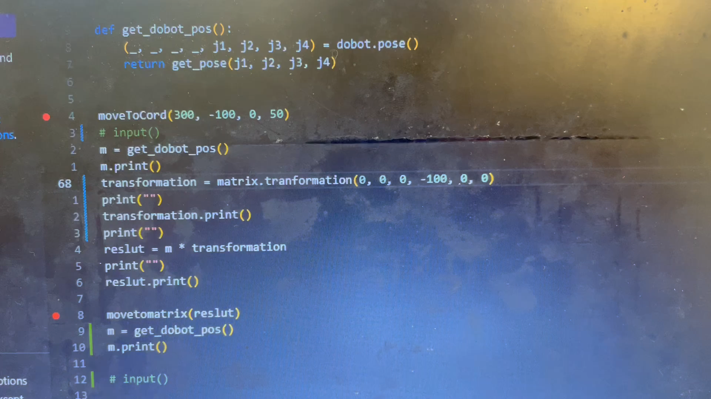

Slide 5
delkonklusioner
Matricer
Homogene transformationer
Denavit-hartenberg notation
Fremadrettet kinematik
Invers kinematik
Python biblotekt
Demostration af Program på dobot
Diskuions

Slide 6
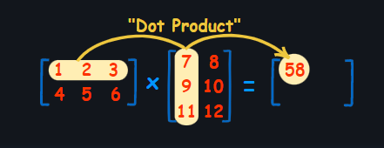
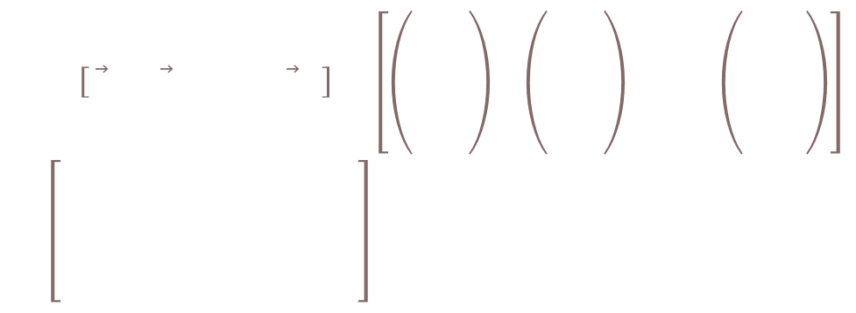


Matricer
$$A=\left[\begin{matrix}{\vec{v}}_{1} & {\vec{v}}_{2} & ⋯ & {\vec{v}}_{m}\end{matrix}\right]=\left[\begin{matrix}\left(\begin{aligned}&v_{1,1} \\ &v_{2,1} \\ &⋮ \\ &v_{n,1}\end{aligned}\right) & \left(\begin{aligned}&v_{1,2} \\ &v_{2,2} \\ &⋮ \\ &v_{n,2}\end{aligned}\right) & \begin{matrix}⋯ & \left(\begin{aligned}&v_{1,m} \\ &v_{2,m} \\ &⋮ \\ &v_{n,m}\end{aligned}\right)\end{matrix}\end{matrix}\right]=\left[\begin{matrix}\begin{aligned}&v_{1,1} \\ &v_{2,1} \\ &⋮ \\ &v_{n,1}\end{aligned} & \begin{aligned}&v_{1,2} \\ &v_{2,2} \\ &⋮ \\ &v_{n,2}\end{aligned} & \begin{matrix}\begin{matrix}⋯ \\ ⋯ \\ \begin{matrix}⋱ \\ ⋯\end{matrix}\end{matrix} & \begin{aligned}&v_{1,m} \\ &v_{2,m} \\ &⋮ \\ &v_{n,m}\end{aligned}\end{matrix}\end{matrix}\right]$$
Hvis $A∈ℝ^{n×m}$ og $B∈ℝ^{m×k}$ og C er givet ved $C=A·B$, så er $C∈ℝ^{n×k}$
$$I=\left[\begin{matrix}1 & 0 & 0 \\ 0 & 1 & 0 \\ 0 & 0 & 1\end{matrix}\right]$$
Billede fra: Pierce, R. (2021. August 25). How to Multiply Matrices. Hentet 8. December 2022 fra Math Is Fun: http://www.mathsisfun.com/algebra/matrix-multiplying.html

Slide 7
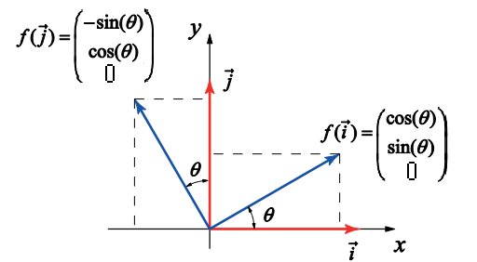


Homogene transformationer med Matricer
$$T=\left[\begin{aligned}R \\ \begin{matrix}0 & 0 & 0\end{matrix}\end{aligned} | \begin{aligned}P \\ 1\end{aligned}\right]$$
$$T=\left[\begin{matrix}{\vec{i}}_{x} & {\vec{j}}_{x} & {\vec{k}}_{x} & q_{x} \\ {\vec{i}}_{y} & {\vec{j}}_{y} & {\vec{k}}_{y} & q_{y} \\ {\vec{i}}_{z} & {\vec{j}}_{z} & {\vec{k}}_{z} & q_{z} \\ 0 & 0 & 0 & 1\end{matrix}\right]$$
$$R=\left[\begin{matrix}f\left(\vec{i}\right) & f\left(\vec{j}\right) & f\left(\vec{k}\right)\end{matrix}\right]=\left[\begin{matrix}\cos\left(θ\right) & −\sin\left(θ\right) & 0 \\ \sin\left(θ\right) & \cos\left(θ\right) & 0 \\ 0 & 0 & 1\end{matrix}\right]$$
Billede fra: Undervisningsministeriet. (27. august 2014). Lineære afbildninger.

Slide 8
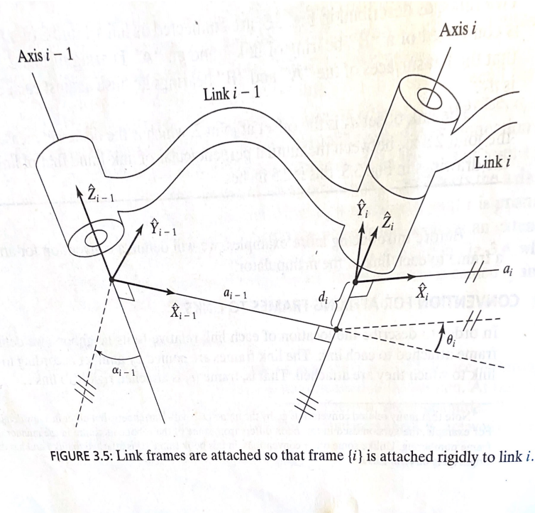

Denavit-hartenberg notation
$${}_{i}^{i−1}T=R_{x}\left(α_{i−1}\right)D_{x}\left(a_{i−1}\right)R_{z}\left(θ_{i}\right)D_{z}\left(d_{i}\right)$$
$${}_{i}^{i−1}T=\left[\begin{matrix}cos⁡(θ_{i}) & −sin⁡(θ_{i}) & 0 & a_{i−1} \\ \sin\left(θ_{i}\right)·cos⁡(α_{i−1}) & \cos\left(θ_{i}\right)·cos⁡(α_{i−1}) & −sin⁡(α_{i−1}) & −\sin\left(α_{1−1}\right)·d_{i} \\ \sin\left(θ_{i}\right)·sin⁡(α_{i−1}) & \cos\left(θ_{i}\right)·sin⁡(α_{i−a}) & cos⁡(α_{i−1}) & \cos\left(α_{i−1}\right)·d_{i} \\ 0 & 0 & 0 & 1\end{matrix}\right]$$
Craig, J. J. (2005). Introduction to Robotics mechanics and control (3 ed.). Upper Saddle River, United States of America: Pearson Prentice Hall. Side 68

Slide 9
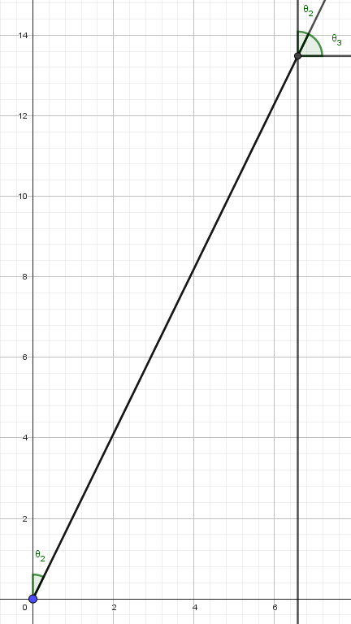
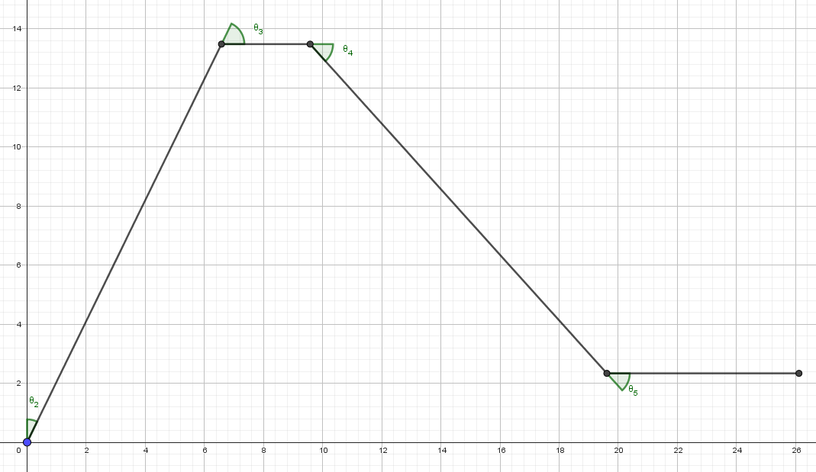
Fremadrettet kinematik

Slide 10
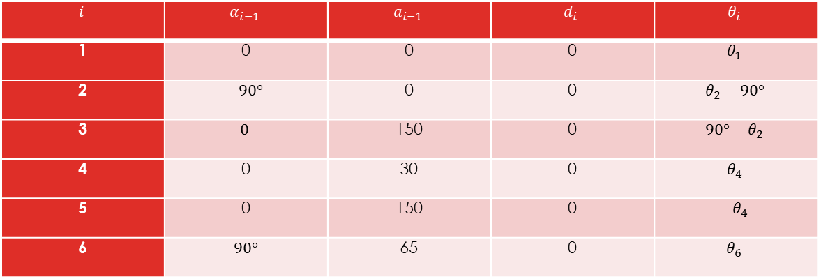

Fremadrettet kinematik
$$i$$ | $$α_{i−1}$$ | $$a_{i−1}$$ | $$d_{i}$$ | $$θ_{i}$$
1 | 0 | 0 | 0 | $$θ_{1}$$
2 | $$−90°$$ | 0 | 0 | $$θ_{2}−90°$$
3 | $$0$$ | 150 | 0 | $${90°−θ}_{2}$$
4 | 0 | 30 | 0 | $$θ_{4}$$
5 | 0 | 150 | 0 | $$−θ_{4}$$
6 | $90°$ | 65 | 0 | $$θ_{6}$$
$${}_{6}^{0}T=\left[\begin{matrix}−sin\left(θ_{1}\right)·sin\left(θ_{6}\right)+ cos\left(θ_{1}\right)·cos(θ_{6}) & −cos\left(θ_{1}\right)·sin\left(θ_{6}\right)− sin\left(θ_{1}\right)·cos(θ_{6}) & 0 & \left(90 + 150·cos\left(θ_{4}\right)+ 150·sin\left(θ_{2}\right)\right)·cos(θ_{1}) \\ cos\left(θ_{1}\right)·sin\left(θ_{6}\right)+ sin\left(θ_{1}\right)·cos(θ_{6}) & −sin\left(θ_{1}\right)·sin\left(θ_{6}\right)+ cos\left(θ_{1}\right)·cos(θ_{6}) & 0 & sin\left(θ_{1}\right)·(90 + 150·cos(θ_{4}) + 150·sin(θ_{2})) \\ 0 & 0 & 1 & −150·sin\left(θ_{4}\right)+ 150·cos(θ_{2}) \\ 0 & 0 & 0 & 1\end{matrix}\right]$$

Slide 11
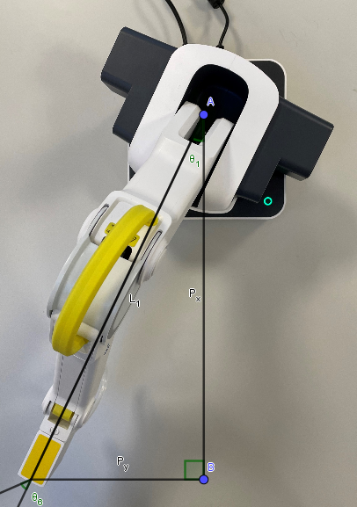
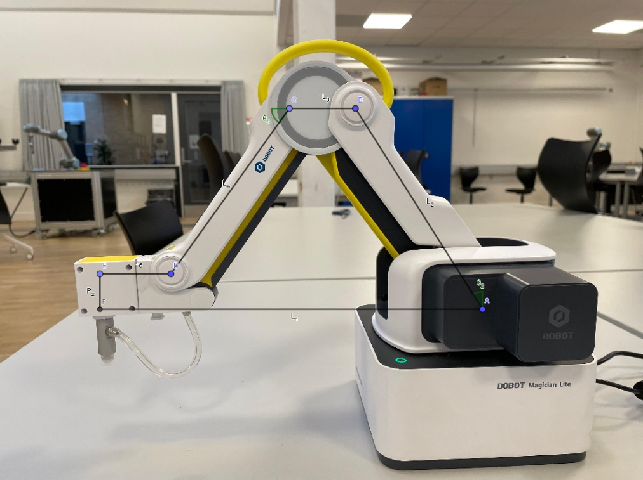
Invers kinematik

Slide 12
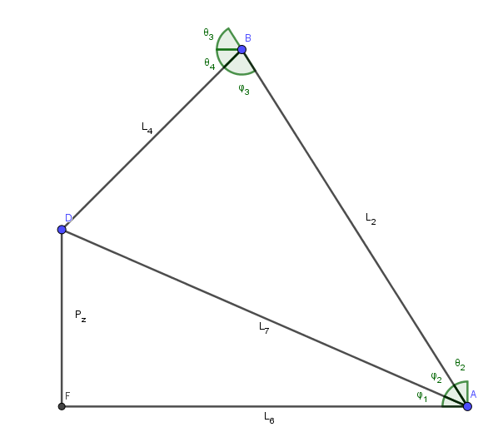

Invers kinematik
$$θ_{1}=\tan^{−1}\left(\frac{P_{y}}{P_{x}}\right) \\ L_{6}=\sqrt{P_{x}^{2}+P_{y}^{2}}−L_{3}−L_{5} \\ L_{7}=\sqrt{P_{z}^{2}+L_{6}^{2}} \\ φ_{1}=\tan^{−1}\left(\frac{P_{z}}{L_{6}}\right) \\ φ_{2}=\cos^{−1}\left(\frac{{L_{7}^{2}+L_{2}^{2}−L}_{4}^{2}}{2·L_{7}·L_{2}}\right) \\ ϕ_{3}=\cos^{−1}\left(\frac{L_{4}^{2}+L_{2}^{2}−L_{7}^{2}}{2·L_{4}·L_{2}}\right) \\ θ_{2}=90−φ_{1}−φ_{2} \\ θ_{4}=180°−θ_{3}−φ_{3} \\ θ_{6}=φ−θ_{1}$$
Hvor
$$P=\left[\begin{matrix}cos⁡(φ) & −sin⁡(φ) & 0 & P_{x} \\ sin⁡(φ) & cos⁡(φ) & 0 & P_{y} \\ 0 & 0 & 1 & P_{z} \\ 0 & 0 & 0 & 1\end{matrix}\right]$$

Slide 13
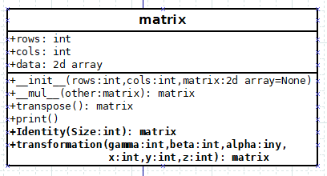
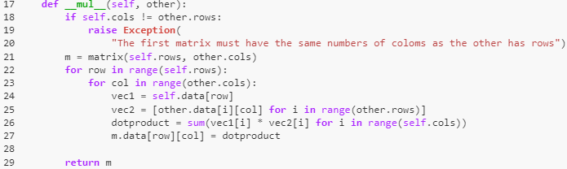
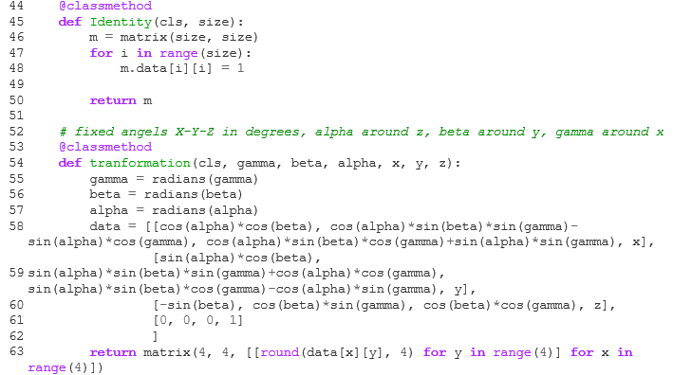
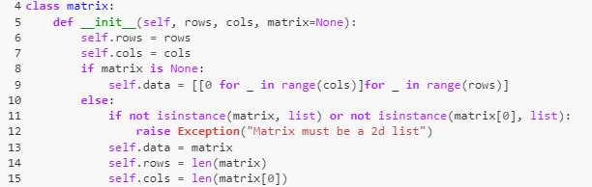
Python Bibliotek til regning med matricer
Klassemetoder, 2 konstruktør

Slide 14
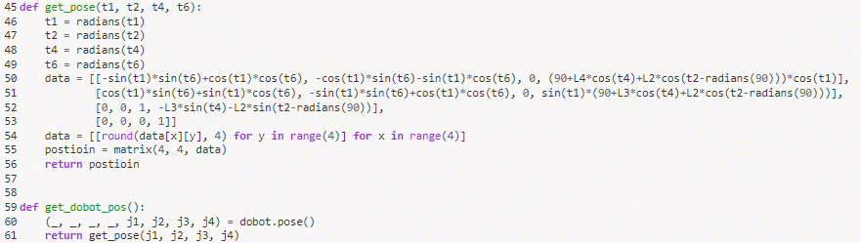
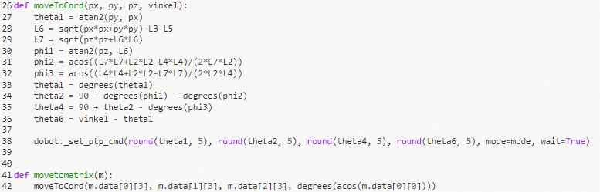
Demonstration af Dobot Kontroler
Bug fix linje 52

Slide 15

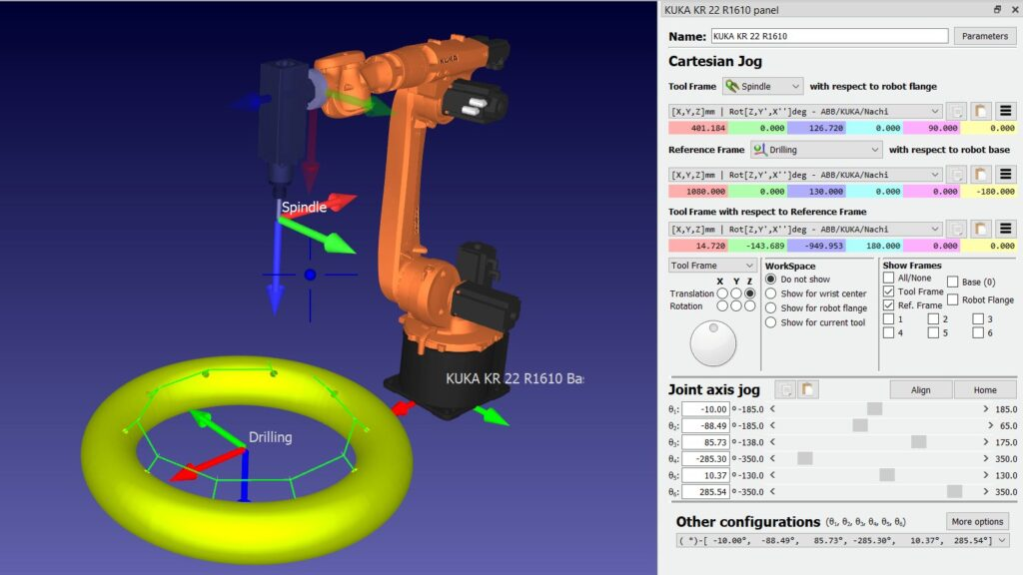
Diskussion
Billede fra: Owen-Hill, A. (14. Juni 2021). Inverse Kinematics in Robotics: What You Need to Know. Hentet fra RoboDK: https://robodk.com/blog/inverse-kinematics-in-robotics-what-you-need-to-know/

Slide 16
Metoder
Matematik
Modelering
Programering

Slide 17
Sammen Spil mellem fagene

Slide 18
Manglende kilde i opgaven
Craig, J. J. (2005). Introduction to Robotics mechanics and control (3 ed.). Upper Saddle River, United States of America: Pearson Prentice Hall.

Slide 19
Skriveprocse
Svært at skrive på dansk

Slide 20
Ausativ og kumkativ

Slide 21
konstruktøren

Slide 22
Multiplikation

Slide 23
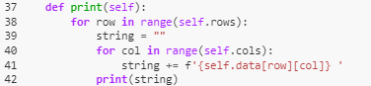
Transpose, Inveter og Print

Slide 24
KlasseMetoder

Slide 25
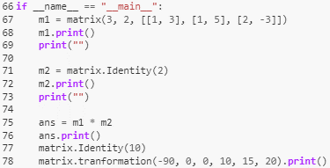
Test af matrix klasse

Slide 26
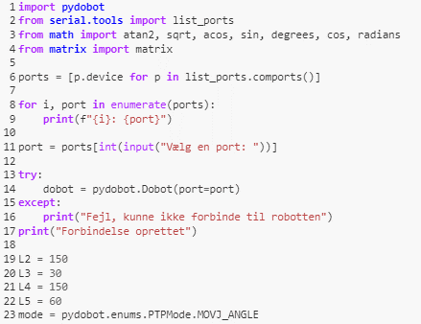
Opsætning af Dobot

Slide 27
Move funktioner

Slide 28
Positionsfunktioner

Slide 29
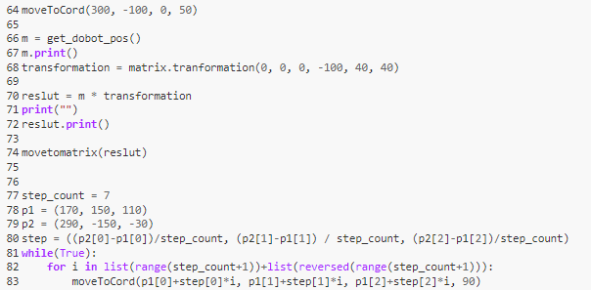
Test Kode

